Slide 1
Analyzing the Sales Performance of Supermarkets
By: Eva Kabura Mwangi
Tools Used: Power BI, Tableau

Slide 2
Introduction
Purpose: To analyze sales data from Shoprite Supermarket and generate insights to improve performance.
Focus Areas:
- Sales by region and branch
- Top-selling products
- Popular payment methods by gender and region

Slide 3
Research Questions
Which region recorded the most sales?
Which branch achieved the greatest gross income?
Which product category generated the most sales?
Which payment method is most popular across regions?
Which payment method is preferred by different genders?

Slide 4
Methodology
Data Cleaning in Excel & Power BI using Power Query
Removed nulls, unnecessary columns, and standardized date formats
Created relationships between relevant tables
Added custom columns (e.g., hour of the day)
Built dashboards in Power BI and Tableau using slicers for interactivity

Slide 5
Data Cleaning Steps
Adjusted date/time formatting in Excel and Power BI
Removed blank rows and errors
Removed unneeded columns (Customer Type, Unit Price, Tax, etc.)
Checked column quality and data distribution
Created custom column: Hour of the Day for peak hour analysis

Slide 6
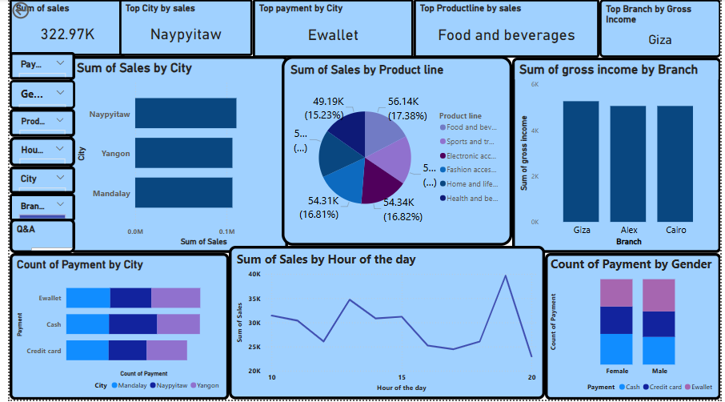
Power BI Dashboard Highlights

Slide 7
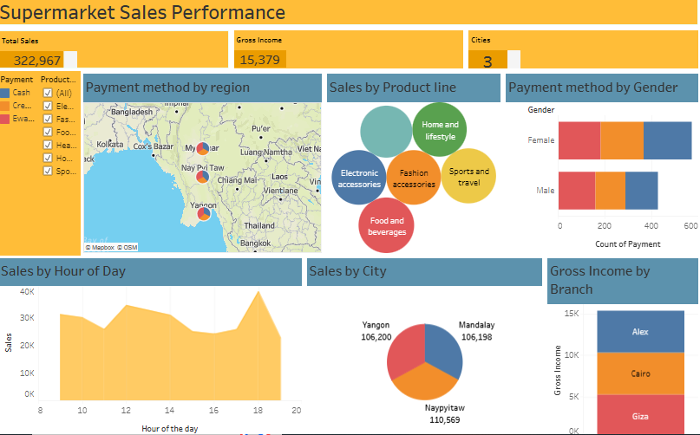
Tableau Dashboard Highlights

Slide 8
Key Insights
Top Region: Naypyitaw
Top Branch: Giza
Top Product: Food and Beverages
Popular Payment Method: Ewallet
Gender Payment Preferences: Female – Cash
Male – Ewallet

Slide 9
Recommendations
Optimize inventory and promotions in high-performing regions
Replicate successful strategies from top branches across others
Improve availability and promotion of best-selling products
Offer more incentives for preferred payment methods
Monitor peak shopping hours for staffing and planning

Slide 10
Deliverables
Data Used: https://www.kaggle.com/code/fareedalianwar/supermarket-sales/notebook
Power BI Dashboard (.pbix file)
Tableau Dashboard : https://public.tableau.com/app/profile/eva.mwangi/viz/Supermarketsalesperfomance_17480533671890/SupermarketSalesPerfomance

Slide 11
Conclusion
A data-driven approach helps identify performance gaps and opportunities
Combining tools like Power BI and Tableau enhances insight generation
Future analyses can incorporate time-based trends and segmentation

